Slide 1

Longitudinal testing of heuristic performance
Analysis of a Tabu Search scheduling algorithm

Slide 2

Problem Setting
One machine job scheduling with job families
Complexity: NP-hard in number of jobs to process
Solution Approach: Local Search / Tabu Search

Slide 3
Job Scheduling
Job Scheduling
N Jobs
Due date (d_{i})
(Release date (r_{i}))
Job family (f_{i})
Processing Time (p_{i})
Setup Time (dependent on job family) (s_{i})
1 Machine
Unconstrained (infinite capacity)

Slide 4
Job Scheduling
Job Scheduling
-
Minimal Maximal Tardiness
Goal
Minimize maximal tardiness (T_{max})
Tardiness relates to jobs completed after the due date
Tardiness T_{i} = max[(C_{i} - d_{i}), 0]; T_{max} = max[T_{i}]
Instances
Instance generator based on Potts & Van Wassenhove
Generator Parameters: Tardiness Factor (T), Spread parameter (R), number of jobs (n), Grouping parameter (g)
T = 0.20; W = 0.60; g = 0.10

Slide 5
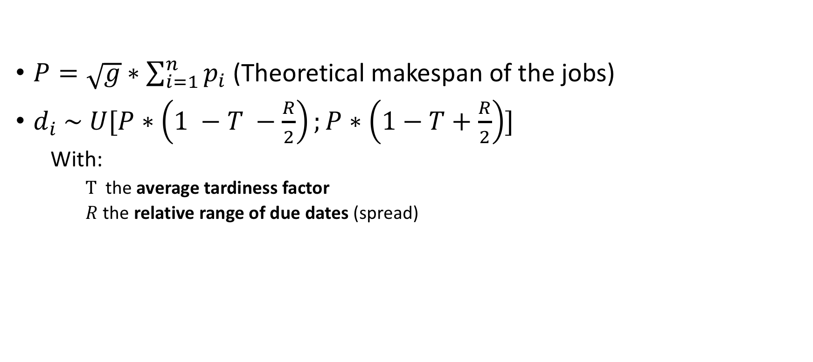
Generator
$P=\sqrt{g}∗\sum_{i=1}^{n}{p_{i}}$ (Theoretical makespan of the jobs)
$d_{i} \sim U[P∗\left(1 −T −\frac{R}{2}\right);P∗\left(1−T+\frac{R}{2}\right)]$
With:
$T$the average tardiness factor
$R$ the relative range of due dates (spread)

Slide 6
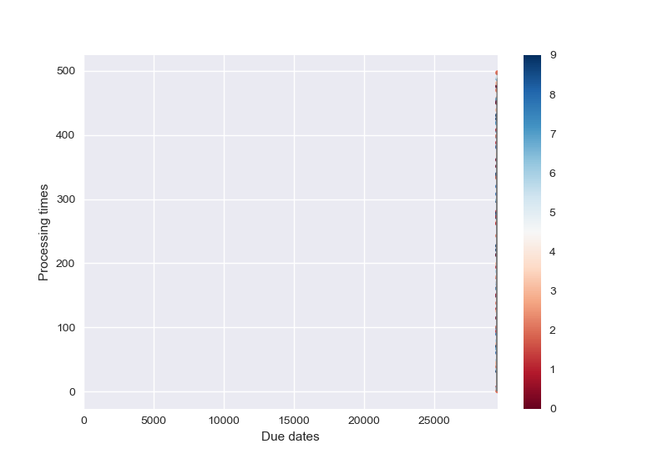
Examples Instance Generation
Tardiness = 0
Spread = 0
n = 100
g = 0.10 (0.10 x 100 = 10 groups)

Slide 7
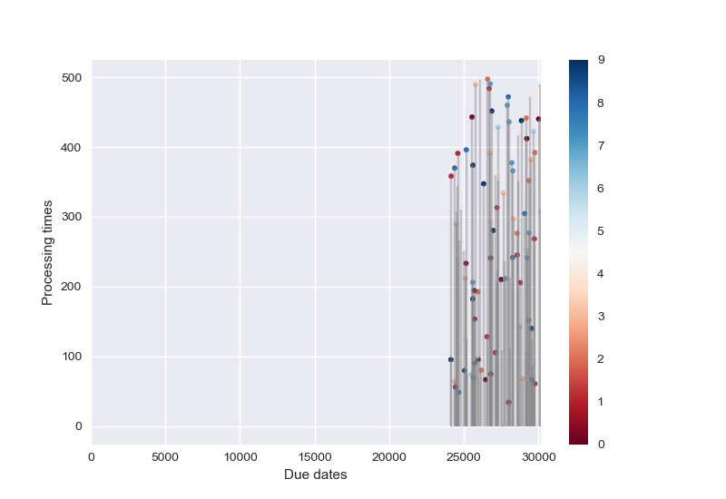
Examples Instance Generation
Tardiness = 0.20
Spread = 0
n = 100
g = 0.10 (0.10 x 100 = 10 groups)

Slide 8
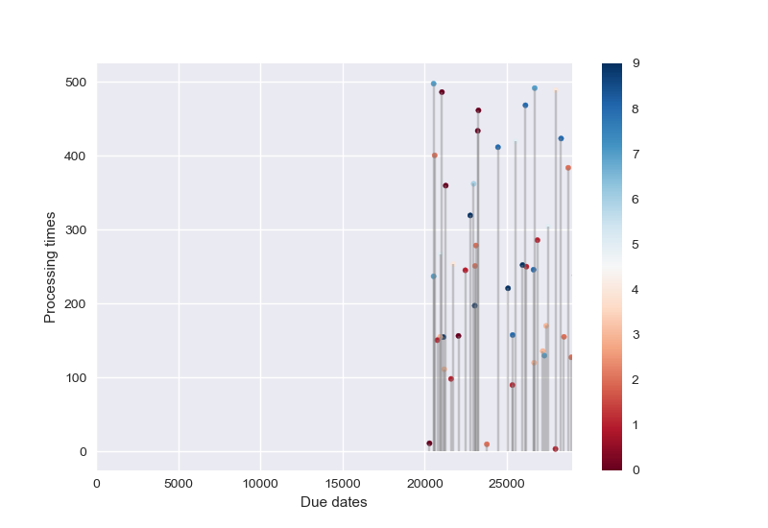
Examples Instance Generation
Tardiness = 0
Spread = 0.60
n = 100
g = 0.10 (0.10 x 100 = 10 groups)

Slide 9
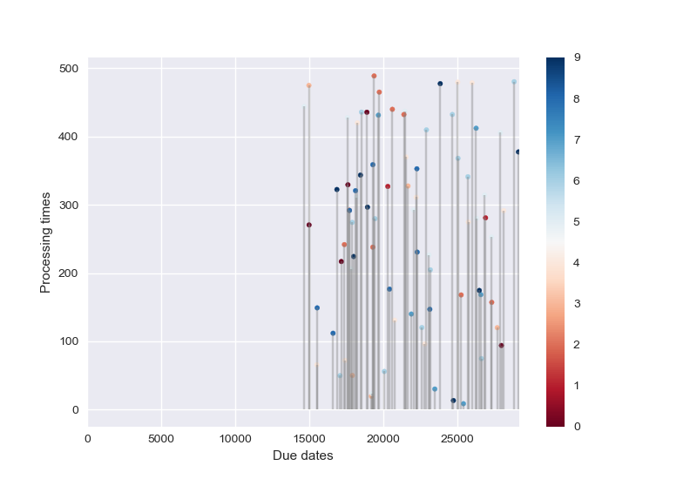
Examples Instance Generation
Tardiness = 0.20
Spread = 0.60
n = 100
g = 0.10 (0.10 x 100 = 10 groups)

Slide 10
Instance Size
Small instances: n = 200
Medium instances: n = 400
Large instances: n = 800

Slide 11
Methodology
20 replicates are generated for each instance size
20 x 3 = 60 (independent) instances
Each instance is solved by all different settings of a local search algorithm
Each run results in a time series of solutions visited by the local search algorithm
We consider these observations as repeated measures on the same subject (instance).

Slide 12

Methodology (2)
Research Questions:
Q1: How can we fit a (linear) model to the output for the different runs
Q2: How do we compare different algorithm components:
Which components reach better solutions
Which components converge faster to an optimal solution
...
Q3: Can we use this methodology to automatically tune algorithm parameters?

Slide 13
Methodology (3)
Linear Mixed Models for repeated measures (longitudinal) data
Mixed models relax the assumption of independence between observations
ε_{i} ̴_{i.i.d.} N(0, 𝜎²)
ε_{i} ̴ MVN(0, R), R is the covariance matrix with specified structure
We consider random slope/ random coefficient models:
Allows for different regression slopes and intercepts for each independent subject (= instances)

Slide 14
Methodology (4)
Factor | Levels | Number
Tabu Tenure | 10, 50, 100 | 3
First-X | 1, 5, 10 | 3
Random Order | True, False | 2
Instance Size | 200, 400, 800 | 3
A full factorial analysis is carried out to test the effects of the different factors.
20 x 3 x 3 x 2 x 3 = 1080 runs were completed
Each run was allowed to solve for 60 seconds
212.911 observations were collected

Slide 15
Explorative Analysis
General Overview

Slide 16
Random Order
Algorithms using the random order tabu search component seem to decrease on average more than their counterparts without the random order component

Slide 17
Tabu Tenure
The effect of random order seems not to be influenced by the tabu tenure.

Slide 18
First-X
The effect of random order seems not to be influenced by the tabu tenure.

Slide 19
Explorative Analysis
Large Instances

Slide 20
Random Order
Algorithms using the random order tabu search component seem to decrease on average more than their counterparts without the random order component

Slide 21
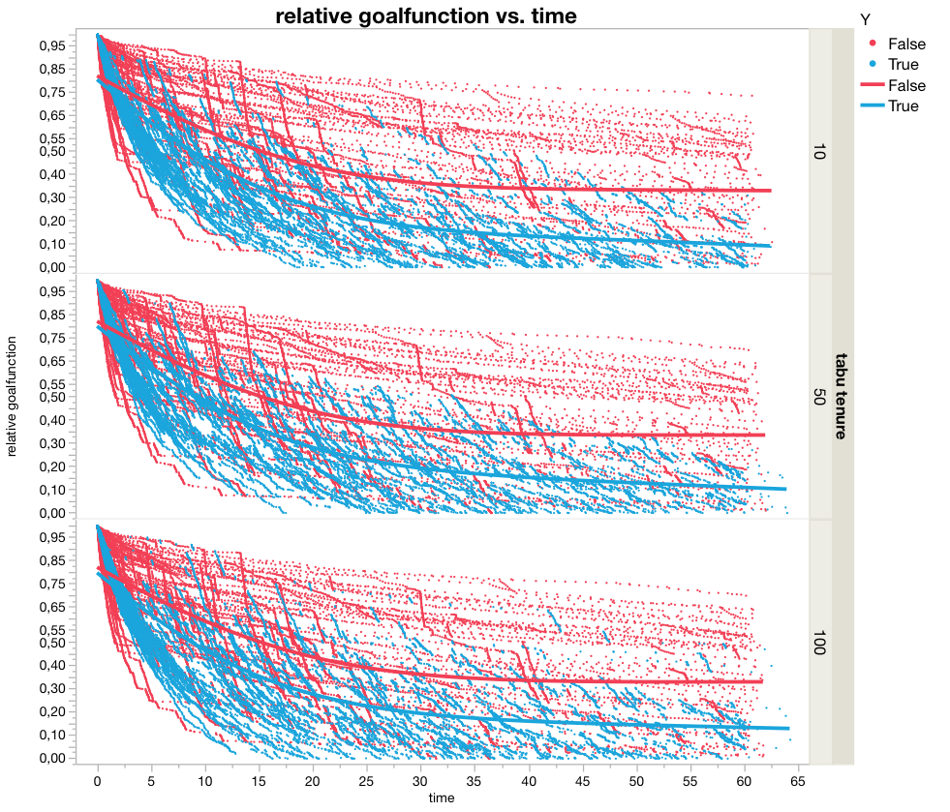
Tabu Tenure

Slide 22
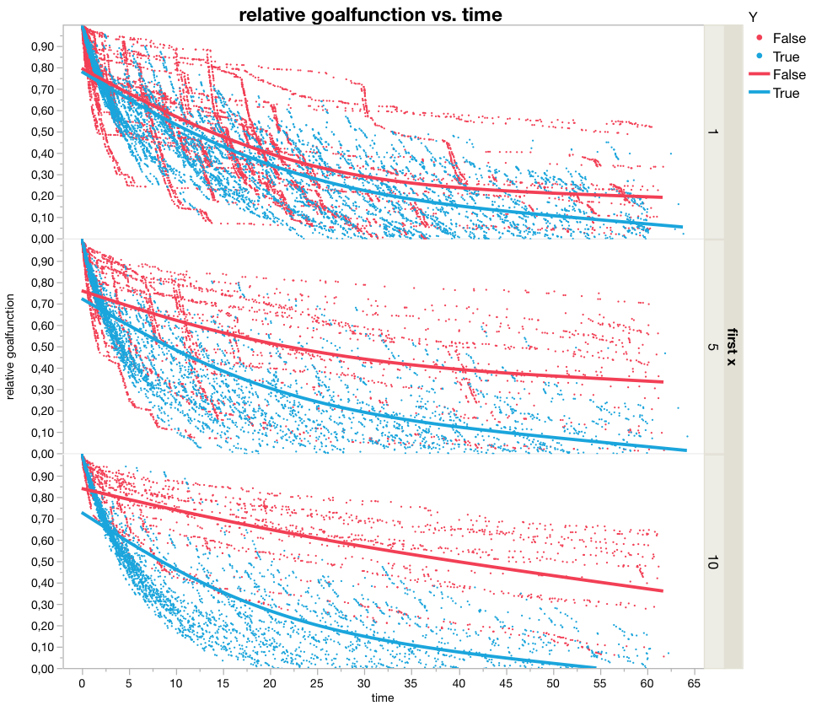
First-X
Algorithms using the random order tabu search component seem to decrease on average more than their counterparts without the random order component

Slide 23
Explorative Analysis
Medium Instances

Slide 24
Random Order
Algorithms using the random order tabu search component seem to decrease on average more than their counterparts without the random order component

Slide 25
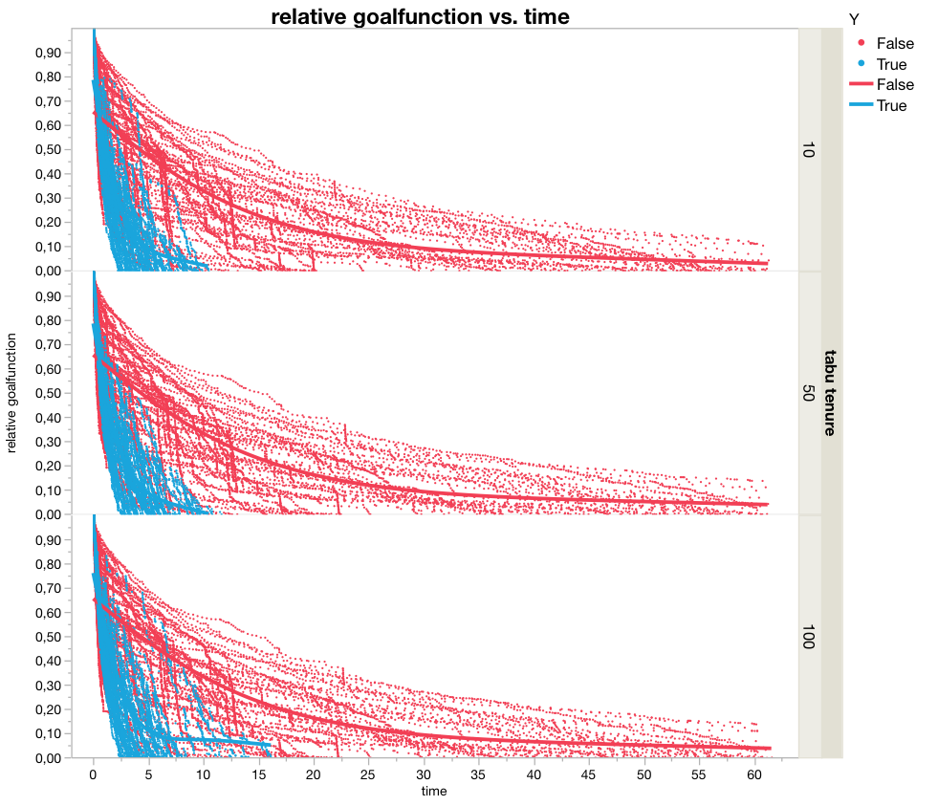
Tabu Tenure

Slide 26
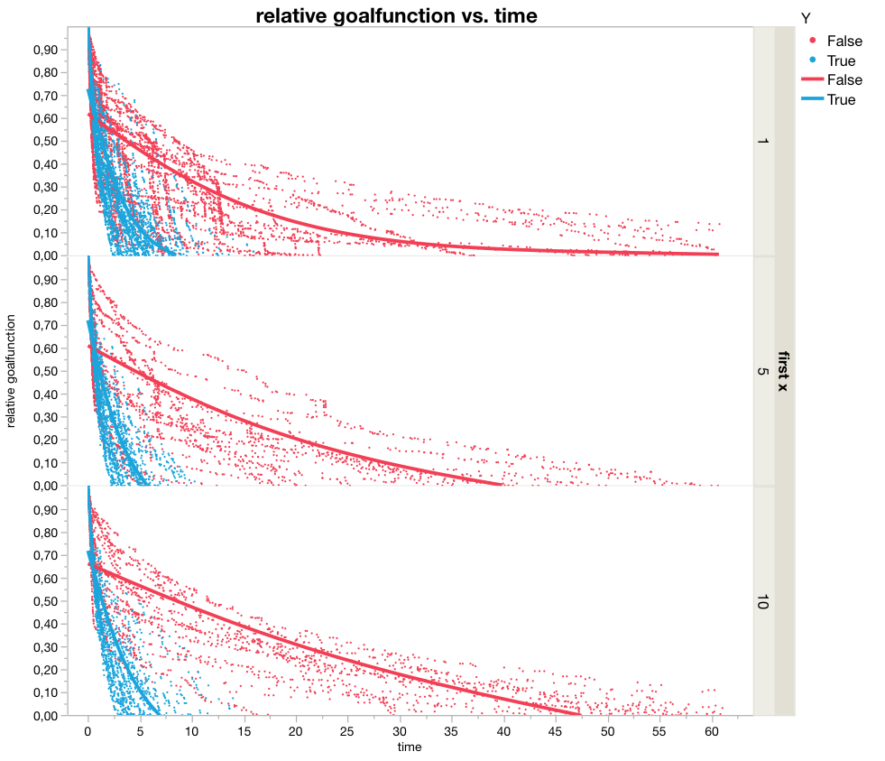
First-X

Slide 27
Explorative Analysis
Small Instances

Slide 28
Random Order
Algorithms using the random order tabu search component seem to decrease on average more than their counterparts without the random order component

Slide 29
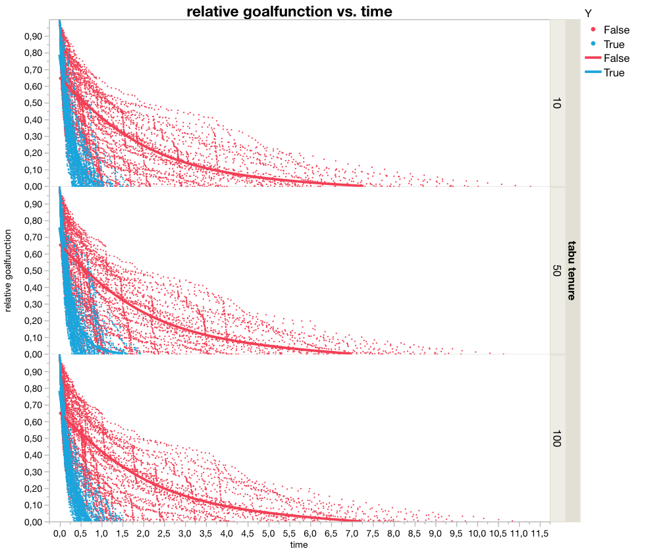
Tabu Tenure

Slide 30
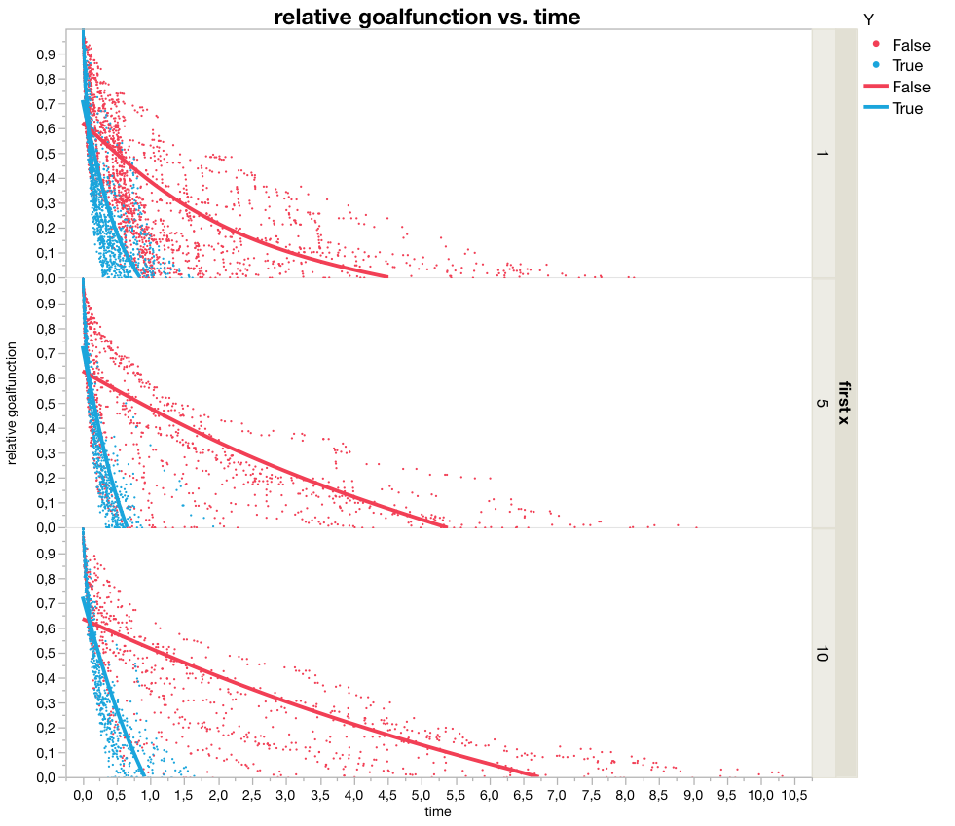
First-X

Slide 31
Fitting a model

Slide 32
Case 1
Large instances
Random order: True
First-X: 1
Tabu tenure: 10
We bin the timeseries into 60 bins (width = 1s), then we take for each instance the mean and median value over the bin, to obtain a smoothed representation of the solutions.

Slide 33
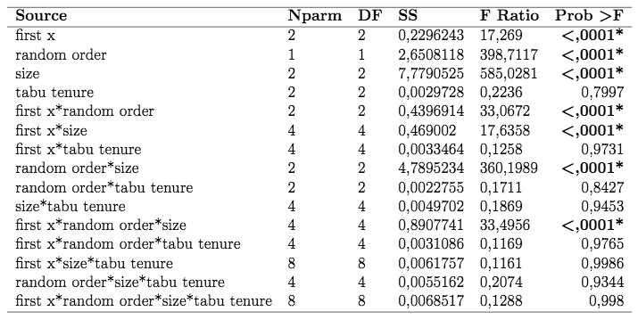
Model 1: Cross Sectional ANOVA
Consider best solution found after 60 seconds for each factor combination

Slide 34
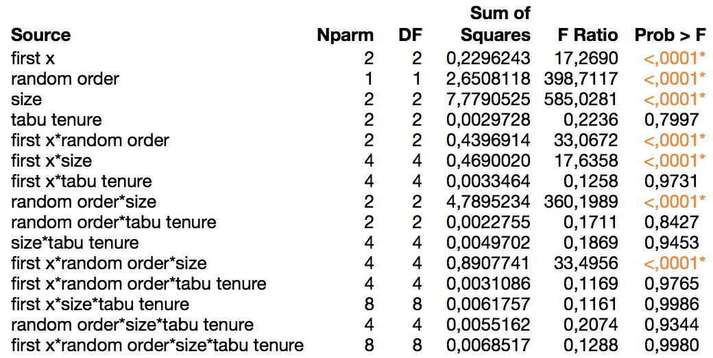
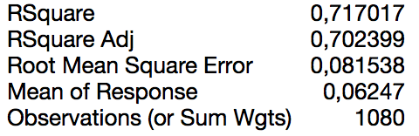
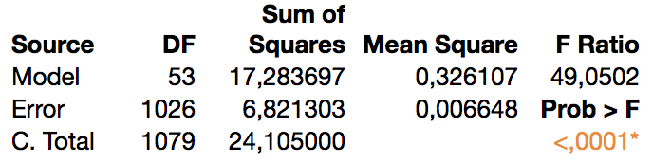
Model 1: Cross Sectional ANOVA
Consider best solution found after 60 seconds for each factor combination

Slide 35
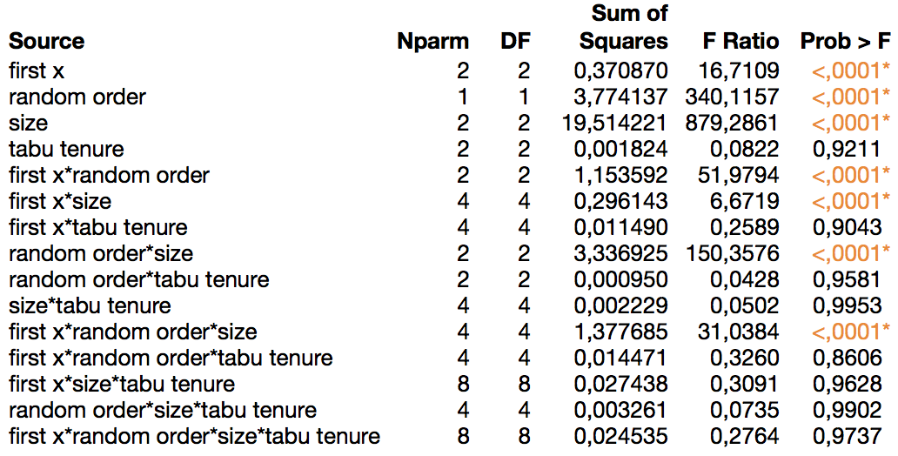
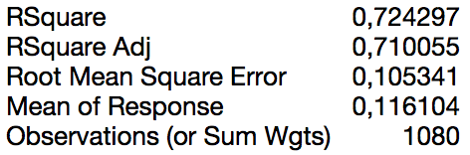
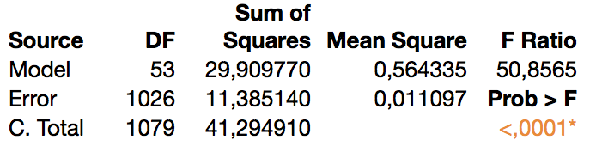
Model 2: Cross Sectional ANOVA
Consider best solution found after 30 seconds for each factor combination

Slide 36
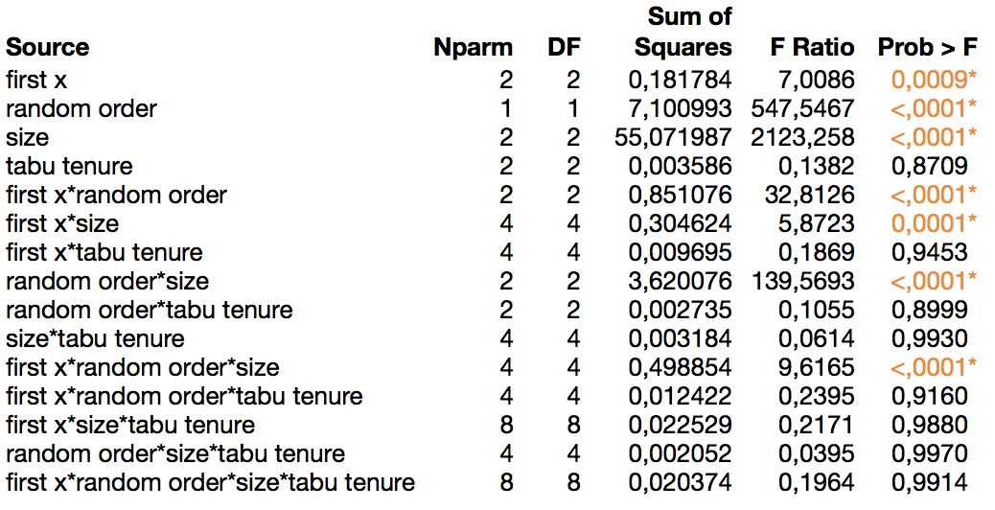
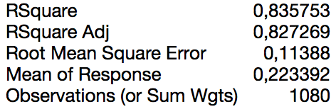
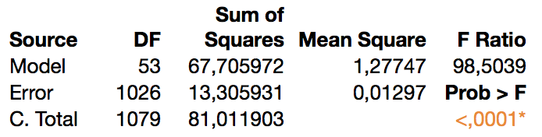
Model 3: Cross Sectional ANOVA
Consider best solution found after 10 seconds for each factor combination

Slide 37
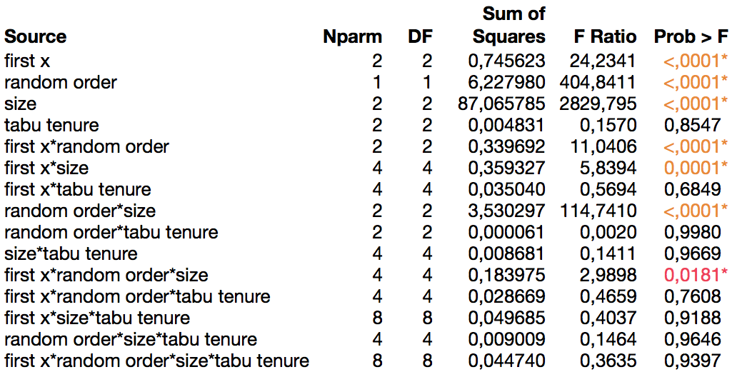
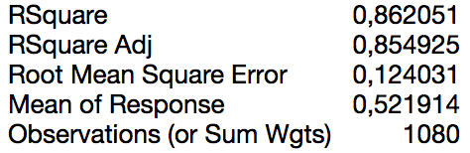
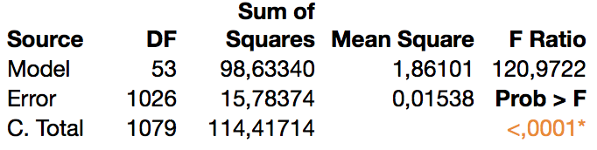
Model 4: Cross Sectional ANOVA
Consider best solution found after 1 second for each factor combination

Slide 38
Interaction Effect: First-X ∗ Random Order
Large Instances
Medium Instances

